Slide 1
ICS2 EO Self-Conformance Test (CT) Support by NAs
ICS2 Release 2 EO Self-CT Campaign
June 2022

Slide 2
Agenda
Welcome
EO business roles
Trigger to start CT execution
Process of CT execution
Execution of EO conformance test cases
Business scenarios for Postal Operators
Business scenarios for Express Operators
Business scenarios for Notify Parties
Business scenarios for Carriers
Business scenarios for House filers
Business Scenario for Person Notifying the Arrival
Questions and Answers

Slide 3
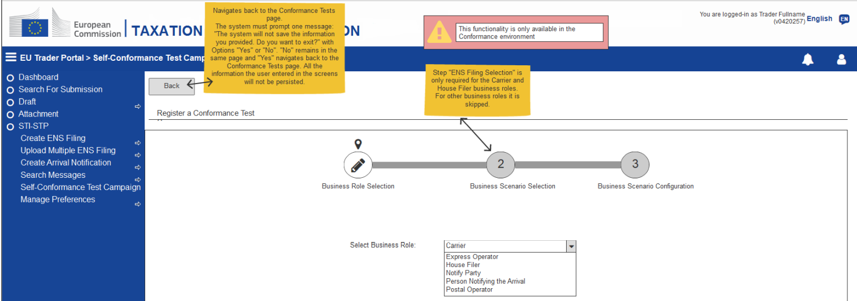
2. EO business roles
A business role is defined as the responsibility to perform specific behavior to which, an actor can be assigned. The business role is determined according to the interaction that an EO’s system has with ICS2. Business roles consist of the following types:
Carrier;
Express Operator;
House Filer;
Notify Party;
Person Notifying the Arrival;
Postal Operator.
STI-STP

Slide 4
3. Trigger to start CT execution
The approach to verify the conformance of the EO systems is based on business scenarios. Those will be triggered from the ICS2 STI-STP Self-Conformance Test Campaign screen, dedicated solely for the purpose of an EO user to configure and execute the conformance test campaigns.
In the ICS2 STI-STP Self-Conformance Test Campaign Configuration screen the EO must select the Sender Party ID from a drop-down list with all the Party IDs that have been configured in Manage Trader Preferences, for the Test Campaign it is going to Register.
STI-STP

Slide 5
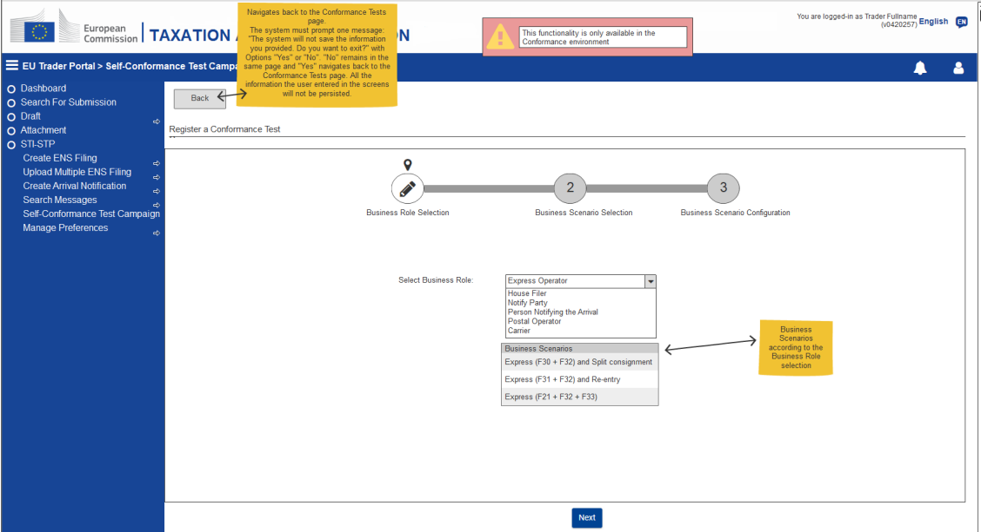
3. Trigger to start CT execution
The second step is to register a new Test Campaign. When registering a new Test Campaign, the EO must select its role;
Depending on this selection, a pre-defined set of business scenarios will be proposed for execution.

Slide 6
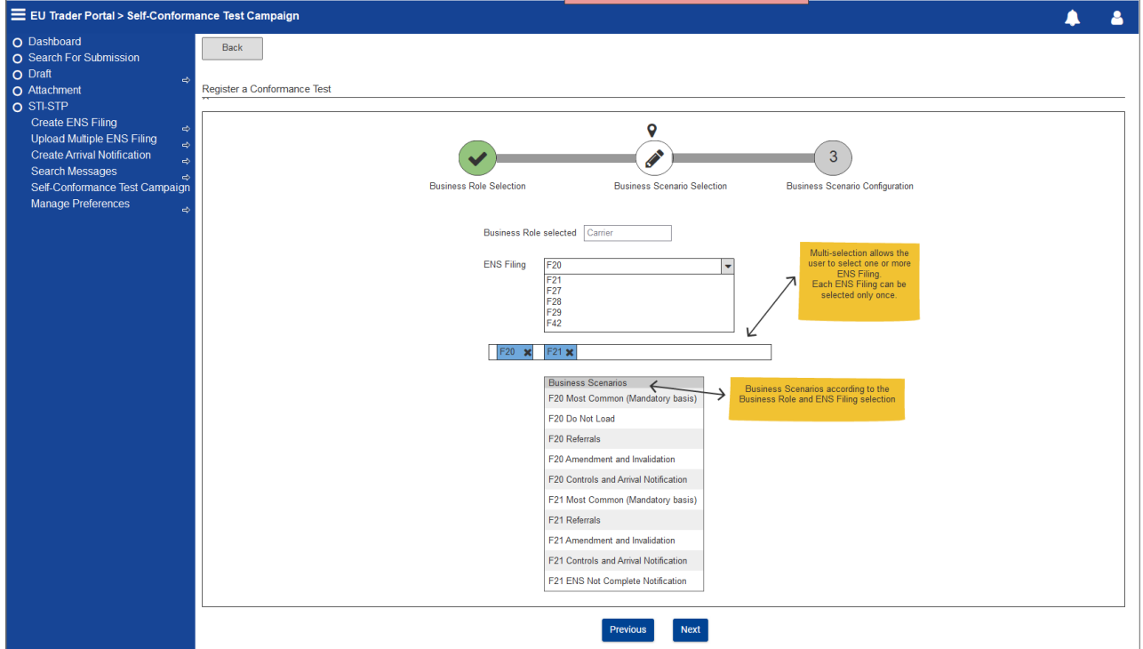
3. Trigger to start CT execution
Alternatively, for Carriers and House Filers, a list with the ENS Filings available for conformance will be displayed.
The next step will be to select which types of filings are applicable to them and a set of business scenarios corresponding to those ENS Filings will be proposed to be executed.

Slide 7
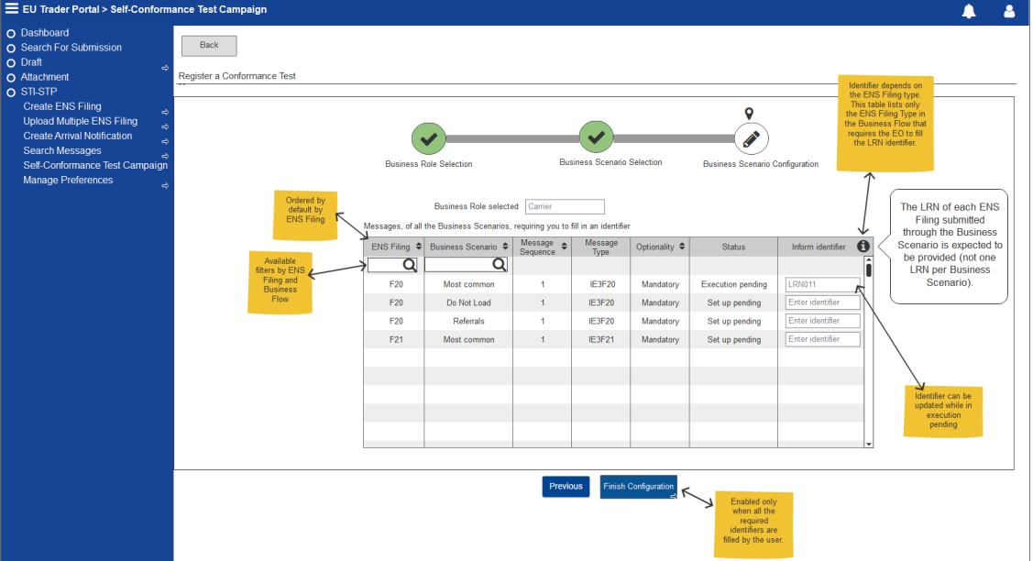
3. Trigger to start CT execution
To finish the configuration, the EO must provide an identification number for the list of messages requiring filling an identifier for the selected Business role and scenario.

Slide 8
3. Trigger to start CT execution
Most of the tests of the EO Business Scenarios are triggered by the EO with a successful Registration of an ENS Filing and reception of the MRN, via the IE3R01 message;
There are some exceptions for which the initial ENS Registration to start the flow must be mocked.
For these scenarios that are depicted below, launch test action will be available in the Test Campaign Business Scenario screen:
‘Notify Party’ Business Scenario;
‘House Filer’ F22 ENS Pending Notification Business Scenario;

Slide 9
3. Trigger to start CT execution
‘House Filer’ F26 ENS Pending Notification Business Scenario;
‘Person Notifying the Arrival’ Business Scenario.
Lastly, for the following scenarios the EO has a passive role and will only receive messages:
‘Notify Party’ Business Scenario;
‘House Filer’ F22 ENS Pending Notification Business Scenario;
‘House Filer’ F26 ENS Pending Notification Business Scenario.

Slide 10
4. Process of CT execution
The EO Self-Conformance Testing consists of the execution of pre-defined Business Scenarios that combine a set of steps to cover a specific functionality of the system. The steps of each business scenario are linked to relevant test cases;
The aim of each business scenario is to test a particular functionality on the EO system and to simulate parties in the process where is needed.
The data to be used for the Self-conformance testing must be customised by EOs similarly to their data to be used in production (e.g., “Declarant”, “Addressed Member State”, "LRN").

Slide 11
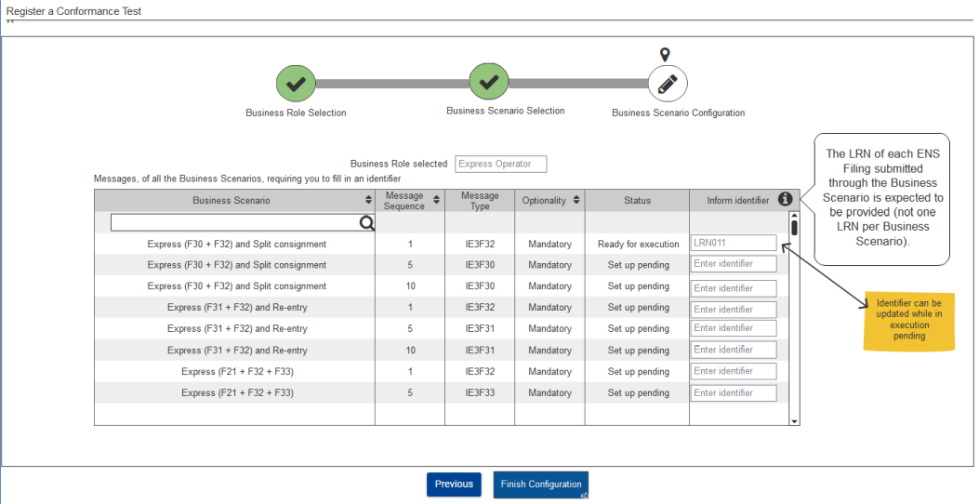
4. Process of CT execution
The message Status has the value ‘Set up pending’ until the user provides the respective identifier for each ENS Filing which will change the message Status to ‘Ready for execution’.
STI-STP UI will provide instructions for any data dependency per business scenario.

Slide 12
4. Process of CT execution
It is possible that the expected response messages sent from STI towards the EO system (such as Assessment complete and RfI/RfS requests) are not generated immediately after the incoming EO message towards the STI.
This occurs due to the fact that there are some applicable timers on the simulated NES messages;
In case there is a validation error (IE3N99) from STI to EO, then this is generated almost immediately.
In case the execution of a particular step from the business scenario fails, then the re-execution resumes from the specific step which failed and it is not required to start from the beginning of the business scenario.

Slide 13
5. Execution of EO conformance test cases
The business scenarios that are presented in the following slides do not concern all the business scenarios that an EO is able to execute. The below business scenarios have been selected in order to depict the principles applicable to the different types of business scenarios:
Postal Business Scenario 1 – Postal most common (F43 and F44);
Postal Business Scenario 3 – Postal, Referrals and ENS consultation (F43 and F44);
Express Business Scenario 1 – Express (F30 + F32) and Split consignment;
Express Business Scenario 2 – Express (F31 + F32) and Re-entry;
Express Business Scenario 3 –Express (F21 + F32 + F33);
Business scenario for Notify Parties;
Carrier Business Scenario - Mandatory basis for F20;
Carrier Business Scenario - Do Not Load for F20;
Carrier Business Scenario – Referrals for F21;

Slide 14
5. Execution of EO conformance test cases
Carrier Business Scenario – Referrals for F28;
Carrier Business Scenario – Amendment and Invalidation for F20;
Carrier Business Scenario - Controls and Arrival Notification for F28;
Carrier Business Scenario - ENS Not Complete Notification for F21;
House filer Business Scenario - Mandatory basis for F24;
House filer Business Scenario – Do not Load for F26;
House filer Business Scenario – Referrals for F24;
House filer Business Scenario – Amendment and Invalidation for F22;
House filer Business Scenario – AEO Control Notification for F26;
House filer Business Scenario - ENS Not Complete Notification for F26;
House filer Business Scenario – ENS Pending Notification for F22;
Business Scenario for Person Notifying the Arrival.

Slide 15
5. Execution of EO conformance test cases
Business scenarios for Postal Operators
For the best readability of the business scenarios under execution, you may find highlighted with blue the messages that the EO has to send to STI.
Business scenarios for Postal Operators
Postal Business Scenario 1 – Postal most common (F43 and F44) (1 out of 5)
This section depicts the most common business scenario for the Postal mode of transport for ICS2 Release 2;
F43 is lodged and assessment complete message is generated for each house consignment, F44 is lodged.

Slide 16
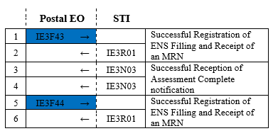
5. Execution of EO conformance test cases
Business scenarios for Postal Operators
Postal Business Scenario 1 – Postal most common (F43 and F44) (2 out of 5)
The depicted number of house consignments included in each message is an example in order to illustrate the sequence of the messages. The number of the receptacles can vary and there are no limitations.
F43 lodged with 2 House consignments
The number of the included house consignments in the ENS filings is not pre-defined and the EO can submit ENS filings with different number of house consignments. The respective number of Assessment complete messages will be generated.
F44 lodged, 1 receptacle containing the 2 House consignments (from F43)

Slide 17
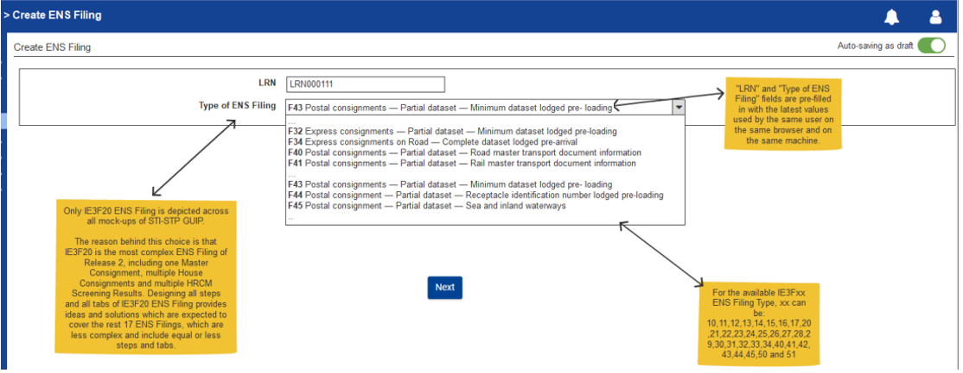
5. Execution of EO conformance test cases
Business scenarios for Postal Operators
Postal Business Scenario 1 – Postal most common (F43 and F44) (3 out of 5)
In STI-STP the EO must create the ENS filings as depicted below:
The EO has the option to create its ENS Filings via STI-STP however the usage of STI-STP is just an alternative. The S2S integration is the main means how to create and lodge ENS Filings.

Slide 18
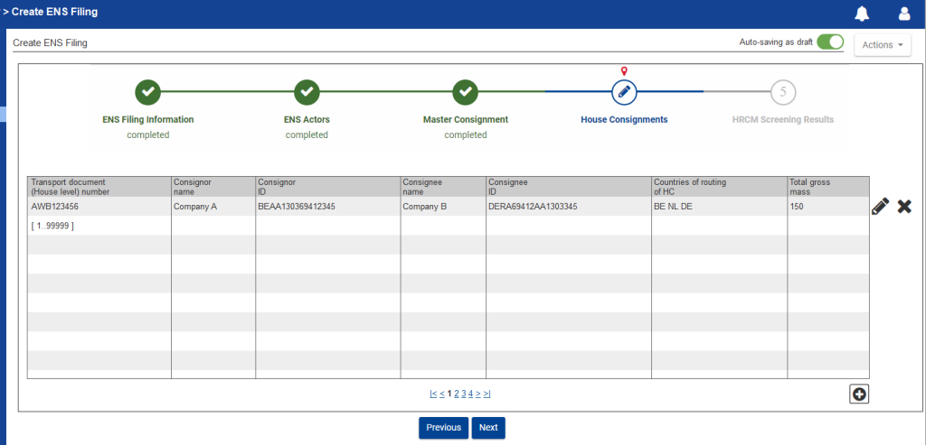
5. Execution of EO conformance test cases
Business scenarios for Postal Operators
Postal Business Scenario 1 – Postal most common (F43 and F44) (4 out of 5)
In STI-STP for the creation of the ENS filings, the EO must include the house consignments as depicted below:

Slide 19
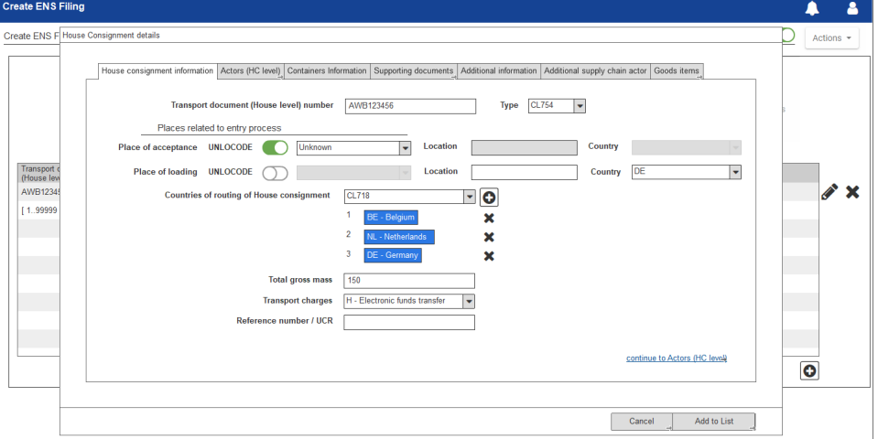
5. Execution of EO conformance test cases
Business scenarios for Postal Operators
Postal Business Scenario 1 – Postal most common (F43 and F44) (5 out of 5)
For each house consignment the EO must complete all the relevant information as depicted below:

Slide 20
5. Execution of EO conformance test cases
Business scenarios for Postal Operators
Postal Business Scenario 3 – Postal, Referrals and ENS consultation (F43 and F44)
(1 out of 4)
This section depicts the business scenario for the Postal mode of transport;
F44 and F43 are lodged. An assessment complete is generated for all the house consignments for which no RfS/RfI are requested;
For one of the house consignments an RfI and an RfS are received and responded;
An assessment complete notification is generated.

Slide 21
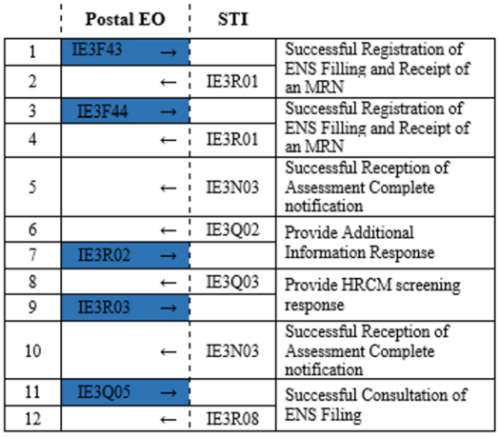
5. Execution of EO conformance test cases
Business scenarios for Postal Operators
Postal Business Scenario 3 – Postal, Referrals and ENS consultation (F43 and F44)
(2 out of 4)
The depicted number of house consignments included in each message is an example in order to illustrate the sequence of the messages. The number of the receptacles can vary and there are no limitations.
F43 lodged with 2 House consignments
F44 lodged (2 receptacles), each containing 1 house consignment from F43
The number of the included house consignments in the ENS filings is not pre-defined and the EO can submit ENS filings with different number of house consignments. The respective number of Assessment complete messages will be generated.
Assessment complete generated for House consignment 1
Assessment complete generated for House consignment 2

Slide 22
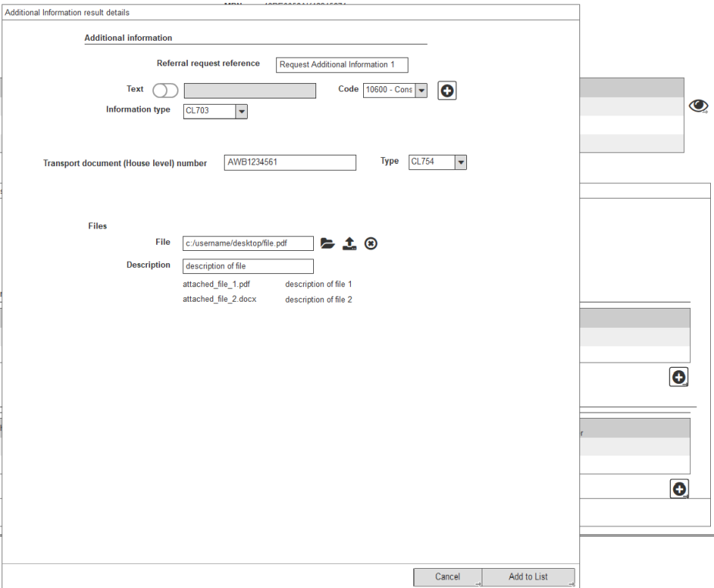
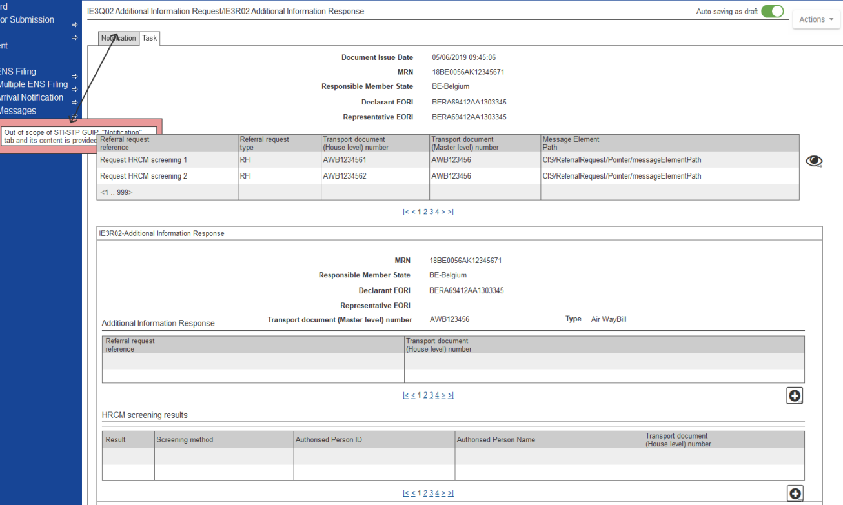
5. Execution of EO conformance test cases
Business scenarios for Postal Operators
Postal Business Scenario 3 – Postal, Referrals and ENS consultation (F43 and F44)
(3 out of 4)
Task IE3Q02 – RFI and Reply to task – IE3R02 in STI-STP

Slide 23
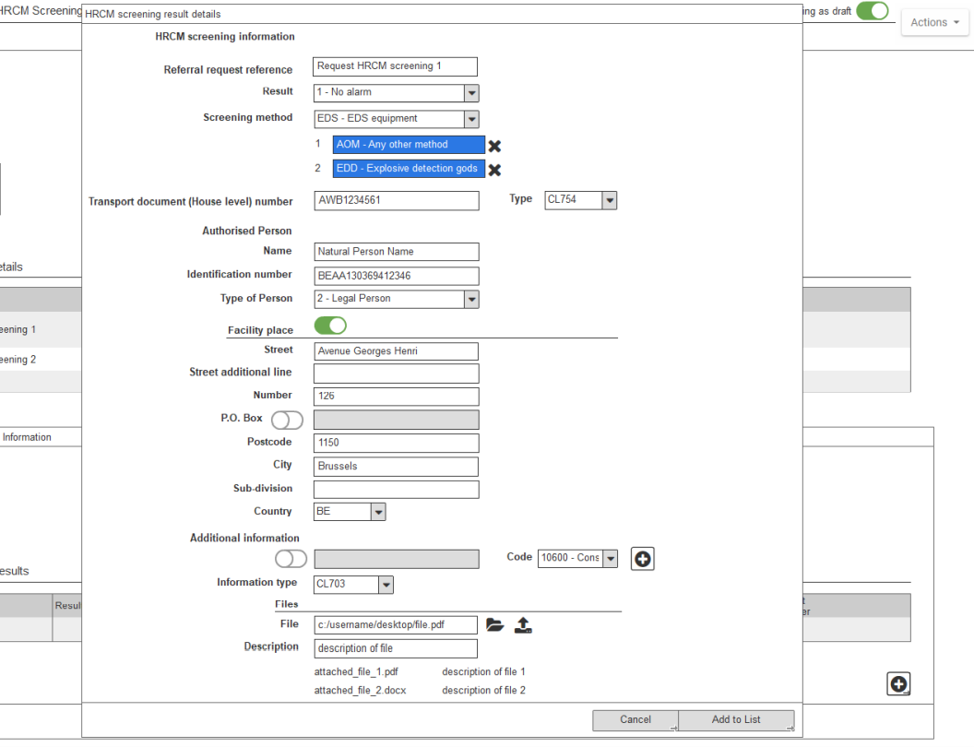
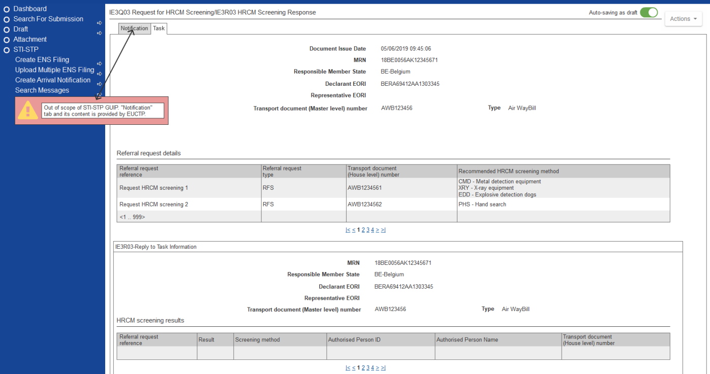
5. Execution of EO conformance test cases
Business scenarios for Postal Operators
Postal Business Scenario 3 – Postal, Referrals and ENS consultation (F43 and F44)
(4 out of 4)
Task IE3Q03 – RFS and Reply to task – IE3R03 in STI-STP

Slide 24
5. Execution of EO conformance test cases
Business scenarios for Express Operators
Business scenarios for Express Operators
Express Business Scenario 1 – Express (F30 + F32) and Split consignment (1 out of 2)
This section depicts the business scenario for the Express mode of transport for ICS2 Release 2 where there is a Split consignment;
F32 is lodged and assessment complete message is generated for each house consignment. F30 is lodged by the Express operator containing the HCs from the F32. An assessment complete is generated. Arrival notification is sent by the Express operator through the STI;
An additional F30 with the same content as the first F30 with the Split consignment indicator is filed. An assessment complete notification is sent. Arrival notification is sent by the Express operator through STI.

Slide 25
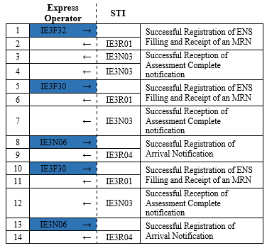
5. Execution of EO conformance test cases
Business scenarios for Express Operators
Express Business Scenario 1 – Express (F30 + F32) and Split consignment (2 out of 2)
F32 lodged with two house consignments
F30 lodged related to the previously lodged F32. The lodged F30 contains both house consignments of F32
The number of the included house consignments in the ENS filings is not pre-defined and the EO can submit ENS filings with different number of house consignments. The respective number of Assessment complete messages will be generated.
Second F30 lodged with the same content as the initial F30 and the Split consignment indicated

Slide 26
5. Execution of EO conformance test cases
Business scenarios for Express Operators
Express Business Scenario 2 – Express (F31 + F32) and Re-entry (1 out of 2)
This section depicts the business scenario for the Express mode of transport for F31 and F32 combination when there is re-entry;
F32 is lodged and assessment complete message is generated for each house consignment, assessment complete notification is sent. F31 containing the master level contract details is received. The means of transport is diverted, and an arrival notification is sent for the second MS;
A new F31 is lodged with a re-entry indicator. The person filing, which hold an AEOS, receives an AEO control notification. The means of transport re-enters the Customs union, the arrival notification is sent and a Control notification is received by the EO.

Slide 27
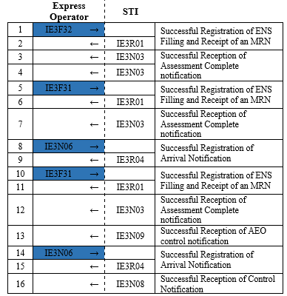
5. Execution of EO conformance test cases
Business scenarios for Express Operators
Express Business Scenario 2 – Express (F31 + F32) and Re-entry (2 out of 2)
F32 lodged with two house consignments
F31 lodged related to the previously lodged F32
The number of the included house consignments in the ENS filings is not pre-defined and the EO can submit ENS filings with different number of house consignments. The respective number of Assessment complete messages will be generated.
The new ENS must be related to the previous one

Slide 28
5. Execution of EO conformance test cases
Business scenarios for Express Operators
Express Business Scenario 3 – Express (F21 + F32 + F33) (1 out of 2)
This section depicts the business scenario for the Express business case where a Carrier submits the master level contract details;
The Express operator files an F32 and assessment complete message is generated for each house consignment, assessment complete notification is sent. The Express operator lodges a F33 with additional House air waybill information. An assessment complete for the ENS is generated after the master level filing is lodged;
The Carrier messages, marked in light grey in the flow, will be simulated in order to send the IE3N03 required messages to the EO during the campaign.

Slide 29
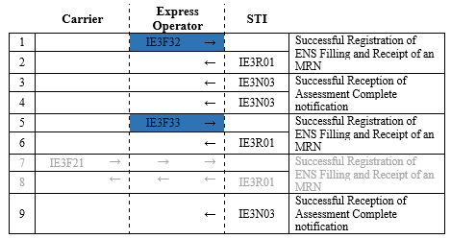
5. Execution of EO conformance test cases
Business scenarios for Express Operators
Express Business Scenario 3 – Express (F21 + F32 + F33) (2 out of 2)
F32 lodged with two house consignments
The number of the included house consignments in the ENS filings is not pre-defined and the EO can submit ENS filings with different number of house consignments. The respective number of Assessment complete messages will be generated.
F33 is lodged by the Express Operator with the information at its disposal without information from the Air Carrier
F21 is lodged whereby the Air Carrier provides extra information to the ENS Filing (this step will be simulated)

Slide 30
5. Execution of EO conformance test cases
Business scenarios for Notify Parties
Business scenarios for Notify Parties
This section depicts the business scenario for a scenario in which the Person filing lodges an F20. An assessment complete notification is sent;
In a simulated flow, the Person notifying the arrival issues an Arrival Notification, which will include the details of the EO performing the tests as Notify party. The EO performing the self-conformance test verifies that for the Notify Party actor receives the notification. The decision to Control the HC is communicated to the Notify Party;
The Person filing and the Person notifying the arrival messages, marked in light grey in the flow, will be simulated in order to send the IE3R04 and IE3N08 required messages to the EO during the campaign. The start of the scenario with these messages will be triggered by the EO during the registration of the campaign.

Slide 31
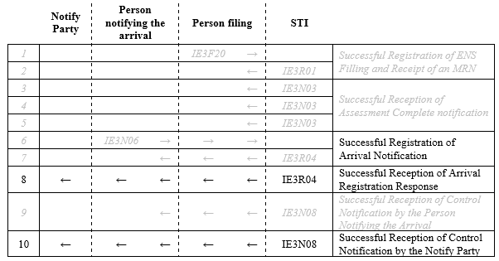
5. Execution of EO conformance test cases
Business scenarios for Notify Parties
ENS Registration (simulated with two house consignments)
Arrival Notification. IE3N06 includes as Notify party the EO performing the self conformance

Slide 32
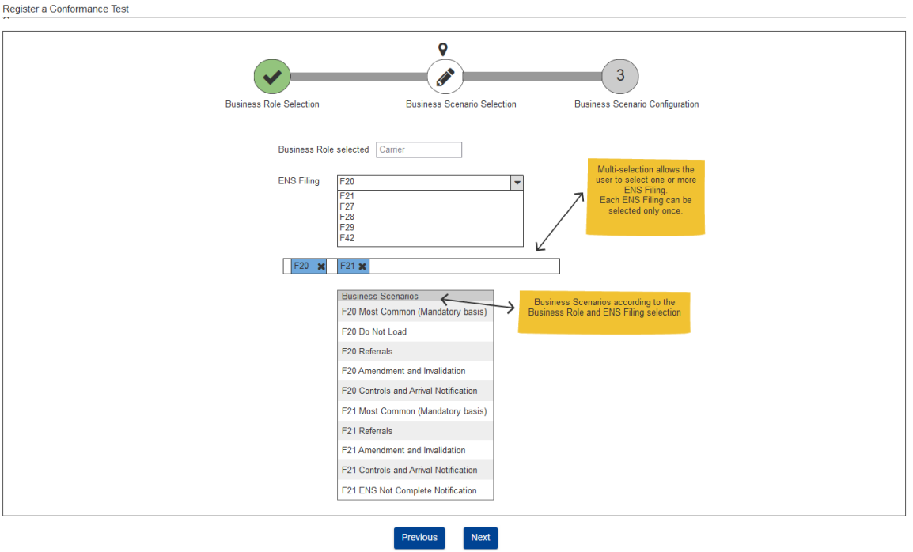
5. Execution of EO conformance test cases
Business scenarios for Carriers
Business scenarios for Carriers
As not all types of filings are applicable for each (air cargo) Carrier, a carrier must select which types of ENS filing they intend to send: F20, F21, F27, F28, F29, F42.
STI-STP

Slide 33
5. Execution of EO conformance test cases
Business scenarios for Carriers
For each ENS filing selected, the table below defines the business cases that must be covered to test the complete functionality.

Slide 34
5. Execution of EO conformance test cases
Business scenarios for Carriers
The functionality will be considered covered once all the business cases applicable per ENS Filing are performed. If more than one ENS filing is selected, all the applicable business cases must be performed for each of them;
As an example, if a carrier selects to support F21 and F42, it should perform the following business cases to cover the complete functionality:
F21 – Most Common flow, Referrals, Amendment and Invalidation, Controls and Arrival Notification and ENS Not Complete Notification;
F42 - Most Common flow, Amendment and Invalidation and Controls and Arrival Notification.
The House filer messages, present in some of the scenarios, will be simulated in order to send the required messages to the EO during the campaign.

Slide 35
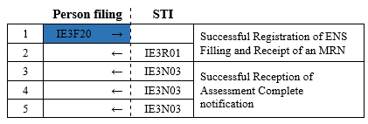
5. Execution of EO conformance test cases
Business scenarios for Carriers
An example business scenario of each business case is defined below.
Carrier Business Scenario - Mandatory basis for F20
This section depicts the mandatory basis business scenario for a Carrier for ICS2 Release 2 when sending an F20.
ENS Registration (with two house consignments)
The number of house consignments in F20 can vary based on the sent F20 ENS filing.
Air pre-loading assessment complete
Pre-arrival assessment complete

Slide 36
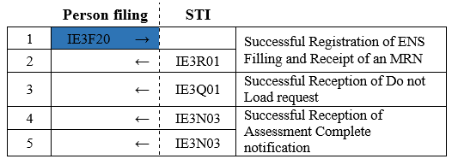
5. Execution of EO conformance test cases
Business scenarios for Carriers
Carrier Business Scenario - Do Not Load for F20
This section depicts the business scenario of Do Not Load for a Carrier for ICS2 Release 2 when sending an F20.
ENS Registration (with two house consignments)
Risk analysis result containing DNL by default for the first house consignment
The number of house consignments in F20 can vary based on the sent F20 ENS filing.
Assessment complete for the other house consignment
Pre-arrival assessment complete

Slide 37
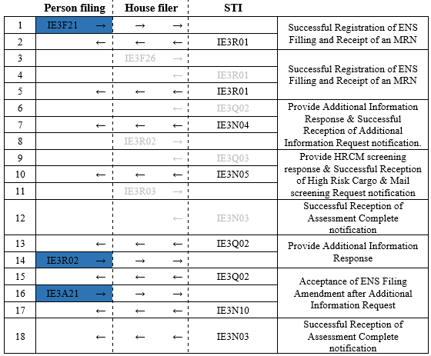
5. Execution of EO conformance test cases
Business scenarios for Carriers
Carrier Business Scenario - Referrals for F21
This section depicts the business scenario of Referrals for a Carrier for ICS2 Release 2 when sending an F21.
Simulated F26 with 1 house consignment
Additional information request notification
HRCM Screening request notification
Amendment after referral

Slide 38
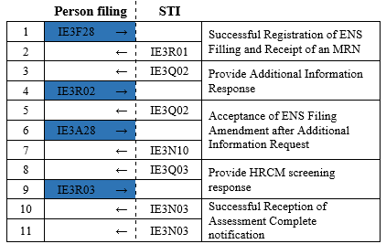
5. Execution of EO conformance test cases
Business scenarios for Carriers
Carrier Business Scenario - Referrals for F28
This section depicts the business scenario of Referrals for a Carrier for ICS2 Release 2 when sending an F28.
Amendment due to a referral
Air pre-loading assessment complete
Assessment complete for pre-arrival

Slide 39
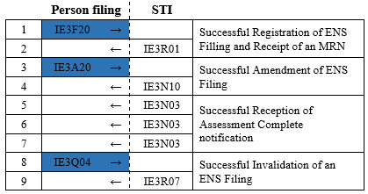
5. Execution of EO conformance test cases
Business scenarios for Carriers
Carrier Business Scenario - Amendment and Invalidation for F20
This section depicts the business scenario of Amendment and invalidation for a Carrier for ICS2 Release 2 when sending an F20.
The number of house consignments in F20 can vary based on the sent F20 ENS filing.
Amendment during Air pre-loading
Air pre-loading assessment complete
Assessment complete for pre-arrival

Slide 40
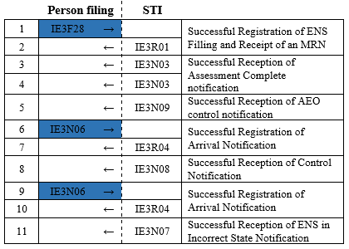
5. Execution of EO conformance test cases
Business scenarios for Carriers
Carrier Business Scenario - Controls and Arrival Notification for F28
This section depicts the business scenario of Controls and Arrival Notification for a Carrier for ICS2 Release 2 when sending an F28.
Assessment complete for pre-arrival
Arrival Notification from the previously lodged ENS filing
A second Arrival notification is lodged to trigger the House consignment in incorrect state notification

Slide 41
5. Execution of EO conformance test cases
Business scenarios for Carriers
Carrier Business Scenario - ENS Not Complete Notification for F21
This section depicts the business scenario of ENS Not Complete Notification for a Carrier for ICS2 Release 2 when sending an F21.
No corresponding ENS filing is simulated for the Supplementary declarant indicated in F21. After the expiration of the linking timer the ENS Not complete notification is sent.

Slide 42
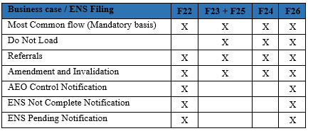
5. Execution of EO conformance test cases
Business scenarios for House filers
Business scenarios for House filers
As not all types of filings are applicable for each (air cargo) House filer, a house filer must select which types of ENS filing they intend to send: F22, F23+F25, F24, F26;
For each ENS filing, the following table defines the business cases that must be covered to test the complete functionality.

Slide 43
5. Execution of EO conformance test cases
Business scenarios for House filers
The EO can consult the Test Campaign that s/he has registered and then view the related business scenarios or launch the test for business scenarios where the initial ENS registration is to be mocked, as depicted below:
STI-STP

Slide 44
5. Execution of EO conformance test cases
Business scenarios for House filers
The functionality will be considered covered once all the business cases applicable per ENS Filing are performed. If more than one ENS filing is selected, all the applicable business cases must be performed for each of them;
As an example, if a house filer selects to support F22 and F24, it should perform the following business cases to cover the complete functionality:
F22 – Most Common flow, Referrals, Amendment and Invalidation, AEO Control Notification, ENS Not Complete Notification and ENS Pending Notification;
F24 - Most Common flow, Do Not Load, Referrals and Amendment and invalidation.

Slide 45
5. Execution of EO conformance test cases
Business scenarios for House filers
An example business scenario of each business case is defined below.
House filer Business Scenario - Mandatory basis for F24 (1 out of 2)
This section depicts the mandatory basis business scenario for a House Filer for ICS2 Release 2 when sending an F24;
The Carrier messages, marked in light grey in the flow, are mocked by the ICS2 Carrier mock, which will send the required messages as response to the EO messages sent during the campaign.

Slide 46
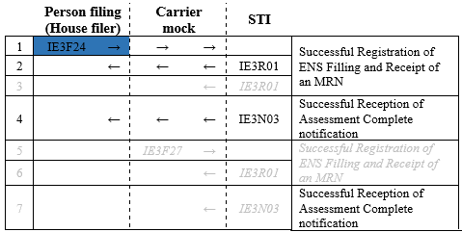
5. Execution of EO conformance test cases
Business scenarios for House filers
House filer Business Scenario - Mandatory basis for F24 (2 out of 2)
ENS Registration (with one house consignments)
The Carrier messages, will be simulated in order to send the required messages to the EO during the campaign.
Air pre-loading assessment complete
It should correspond to the number of the house consignments lodged with F24 (for simplicity reasons here 1 house consignment is included)

Slide 47
5. Execution of EO conformance test cases
Business scenarios for House filers
House filer Business Scenario - Do not Load for F26
This section depicts the business scenario of Do not Load for a House filer for ICS2 Release 2 when sending an F26.

Slide 48
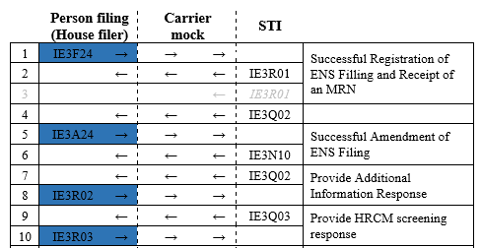
5. Execution of EO conformance test cases
Business scenarios for House filers
House filer Business Scenario - Referrals for F24 (1 out of 2)
This section depicts the business scenario of Referrals for a House filer for ICS2 Release 2 when sending an F24;
The Carrier messages, marked in light grey in the flow, are mocked by the ICS2 Carrier mock, which will send the required messages as response to the EO messages sent during the campaign.
Amendment for the already lodged ENS Filing

Slide 49
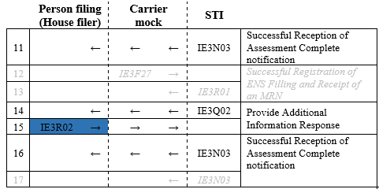
5. Execution of EO conformance test cases
Business scenarios for House filers
House filer Business Scenario - Referrals for F24 (2 out of 2)
The Carrier messages will be simulated in order to send the required messages to the EO during the campaign.

Slide 50
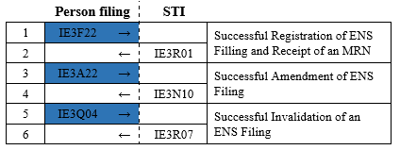
5. Execution of EO conformance test cases
Business scenarios for House filers
House filer Business Scenario - Amendment and Invalidation for F22
This section depicts the business scenario of Amendment and invalidation for a House filer for ICS2 Release 2 when sending an F22.

Slide 51
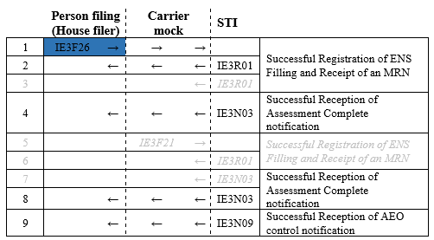
5. Execution of EO conformance test cases
Business scenarios for House filers
House filer Business Scenario - AEO Control Notification for F26 (1 out of 2)
This section depicts the business scenario of AEO notification for a House filer for ICS2 Release 2 when sending an F26.
ENS Registration (with one house consignments)
The Carrier messages will be simulated in order to send the required messages to the EO during the campaign.
Air pre-loading assessment complete
(It should correspond to the number of the house consignments lodged with F26)

Slide 52
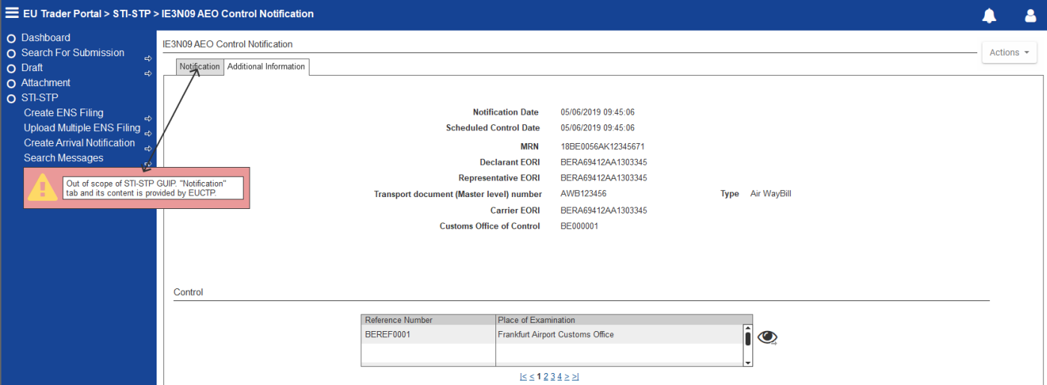
5. Execution of EO conformance test cases
Business scenarios for House filers
House filer Business Scenario - AEO Control Notification for F26 (2 out of 2)
The AEO will be notified about the controls that will be performed on the goods that are under its responsibility. STI sends an (AEOS) Control Notification with ID IE3N09 to the Person Filing, as depicted below:
STI-STP

Slide 53
5. Execution of EO conformance test cases
Business scenarios for House filers
House filer Business Scenario - ENS Not Complete Notification for F26
This section depicts the business scenario of ENS Not Complete Notification for a House filer for ICS2 Release 2 when sending an F26.
ENS Registration. A supplementary declarant needs to be indicated.
No corresponding ENS filing is simulated for the Supplementary declarant indicated in F26. After the expiration of the linking timer the ENS Not complete notification is sent.

Slide 54
5. Execution of EO conformance test cases
Business scenarios for House filers
House filer Business Scenario - ENS Pending Notification for F22
This section depicts the business scenario of ENS Pending notification for a House filer for ICS2 Release 2 when sending an F22.
The Carrier messages, will be simulated in order to send the required messages to the EO during the campaign.
The supplementary declarant in the simulated F21 is the one performing the self conformance.
No F22 is lodged

Slide 55
5. Execution of EO conformance test cases
Business scenarios for Person Notifying the Arrival
Business scenarios for Person Notifying the Arrival
This section depicts the business scenario in which the Person filing lodges a F20, the Person’s filing steps will be simulated;
The Person notifying the arrival sends an Arrival Notification for the means of transport. The decision to Control the HC is communicated to the Person notifying the arrival;
A second Arrival notification is sent, with the same identifier previously used, and Incorrect State Notification is triggered and sent to the Person Notifying the arrival;
The Person filing messages, marked in grey in the flow, will be simulated in order to generate the MRN required for the EO messages sent during the campaign. The generated MRN is a pre-condition to fill the Related MRN in IE3N06 messages to be sent by the Person Notifying the Arrival.

Slide 56
5. Execution of EO conformance test cases
Business scenarios for Person Notifying the Arrival
The EO can launch the business scenario with business role ‘Person Notifying the Arrival’ as depicted below:

Slide 57
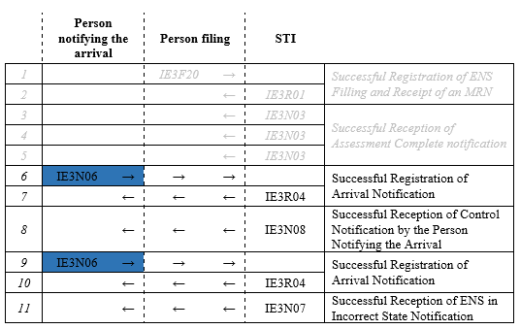
5. Execution of EO conformance test cases
Business scenarios for Person Notifying the Arrival
ENS Registration (to be simulated with two house consignments)
Air pre-loading assessment complete
Assessment complete for pre-arrival
A second Arrival notification (with the same identifier previously used) is lodged to trigger the House consignment in incorrect state notification

Slide 58
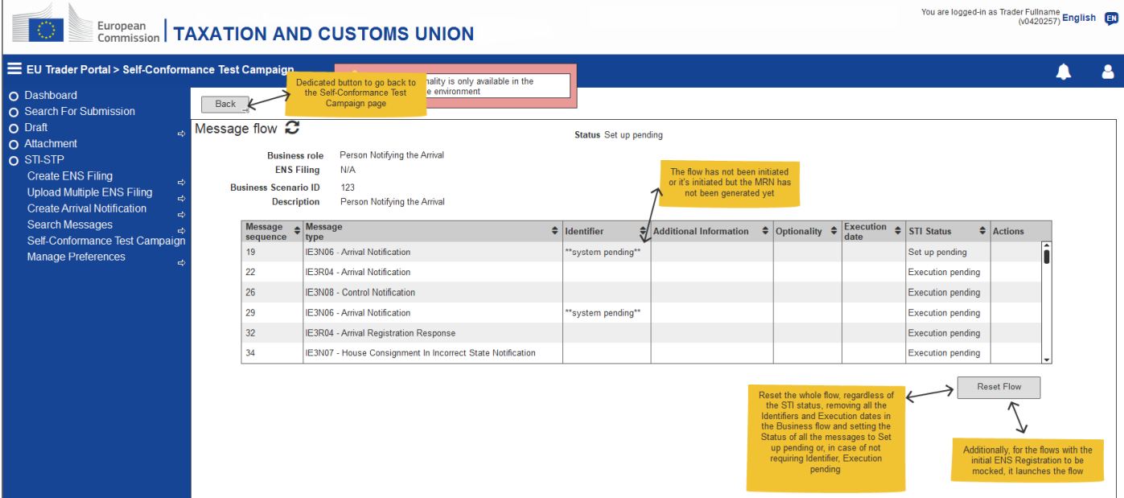
5. Execution of EO conformance test cases
Business scenarios for Person Notifying the Arrival
The EO can view the message flow of the business scenario as depicted below:

Slide 59
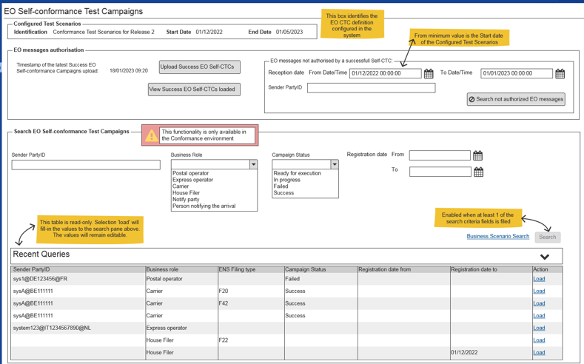
5. Execution of EO conformance test cases
The user (MS) may consult the registered EO Self-conformance Test Campaigns and follow up the execution of the related Business Scenarios in MON&BS.

Slide 60
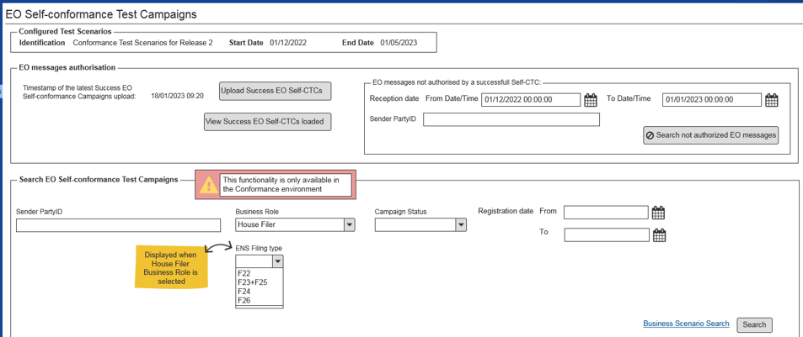
5. Execution of EO conformance test cases
In MON&BS ‘EO Self-conformance Test Campaigns’ page, the user can search the registered EO Self-conformance Test Campaigns, as depicted below:

Slide 61
5. Execution of EO conformance test cases
In MON&BS ‘Search EO Self-conformance Campaign Result’ page, the user may consult the registered EO Self-conformance Test Campaigns and their respective status, as depicted below:

Slide 62
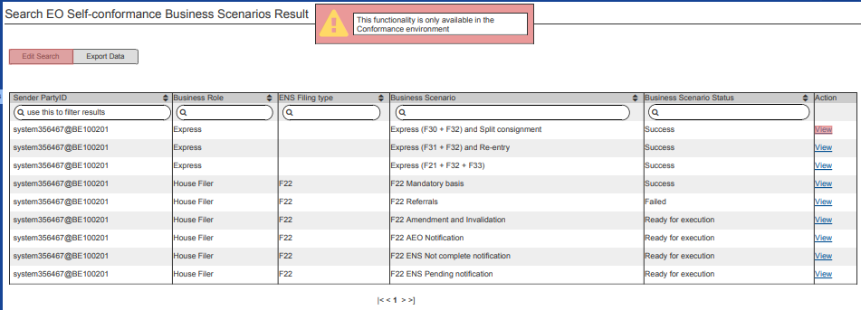
5. Execution of EO conformance test cases
In MON&BS ‘Search EO Self-conformance Business Scenarios Result’ page the user may consult the results of an EO Self-Conformance Test Campaign at Business Scenario level.

Slide 63
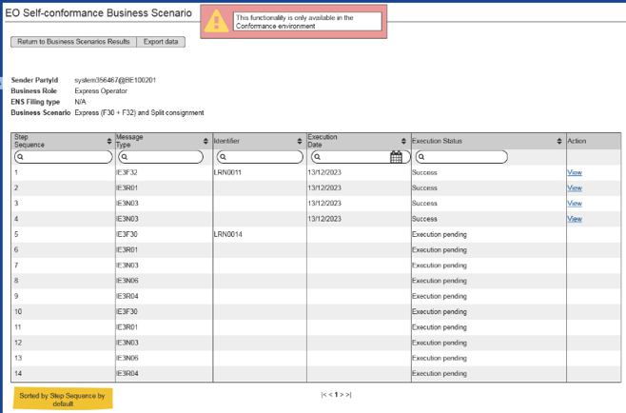
5. Execution of EO conformance test cases
In MON&BS the View ‘EO Self-conformance Business Scenario’ page is the area where the user can consult the details of the messages included in the flow of a Business Scenario.

Slide 64
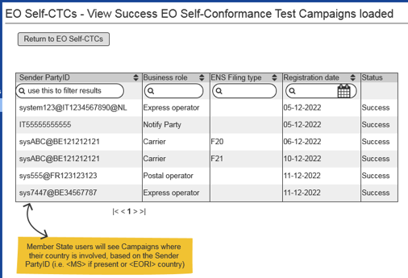
5. Execution of EO conformance test cases
In MON&BS Production environment the user can upload a file with the success EO Self-Conformance Test Campaigns, previously downloaded from the Conformance environment. In MON&BS Production environment the View Success Campaigns loaded page is the area where the user can consult the Success EO Self-conformance Test Campaigns currently loaded in the system.

Slide 65
6. Questions and Answers

Slide 66
Thank you
© European Union 2022
Unless otherwise noted the reuse of this presentation is authorised under the CC BY 4.0 license. For any use or reproduction of elements that are not owned by the EU, permission may need to be sought directly from the respective right holders.
Notes:
Update/add/delete parts of the copy right notice where appropriate.
More information: https://myintracomm.ec.europa.eu/corp/intellectual-property/Documents/2019_Reuse-guidelines%28CC-BY%29.pdf

